Slide 1

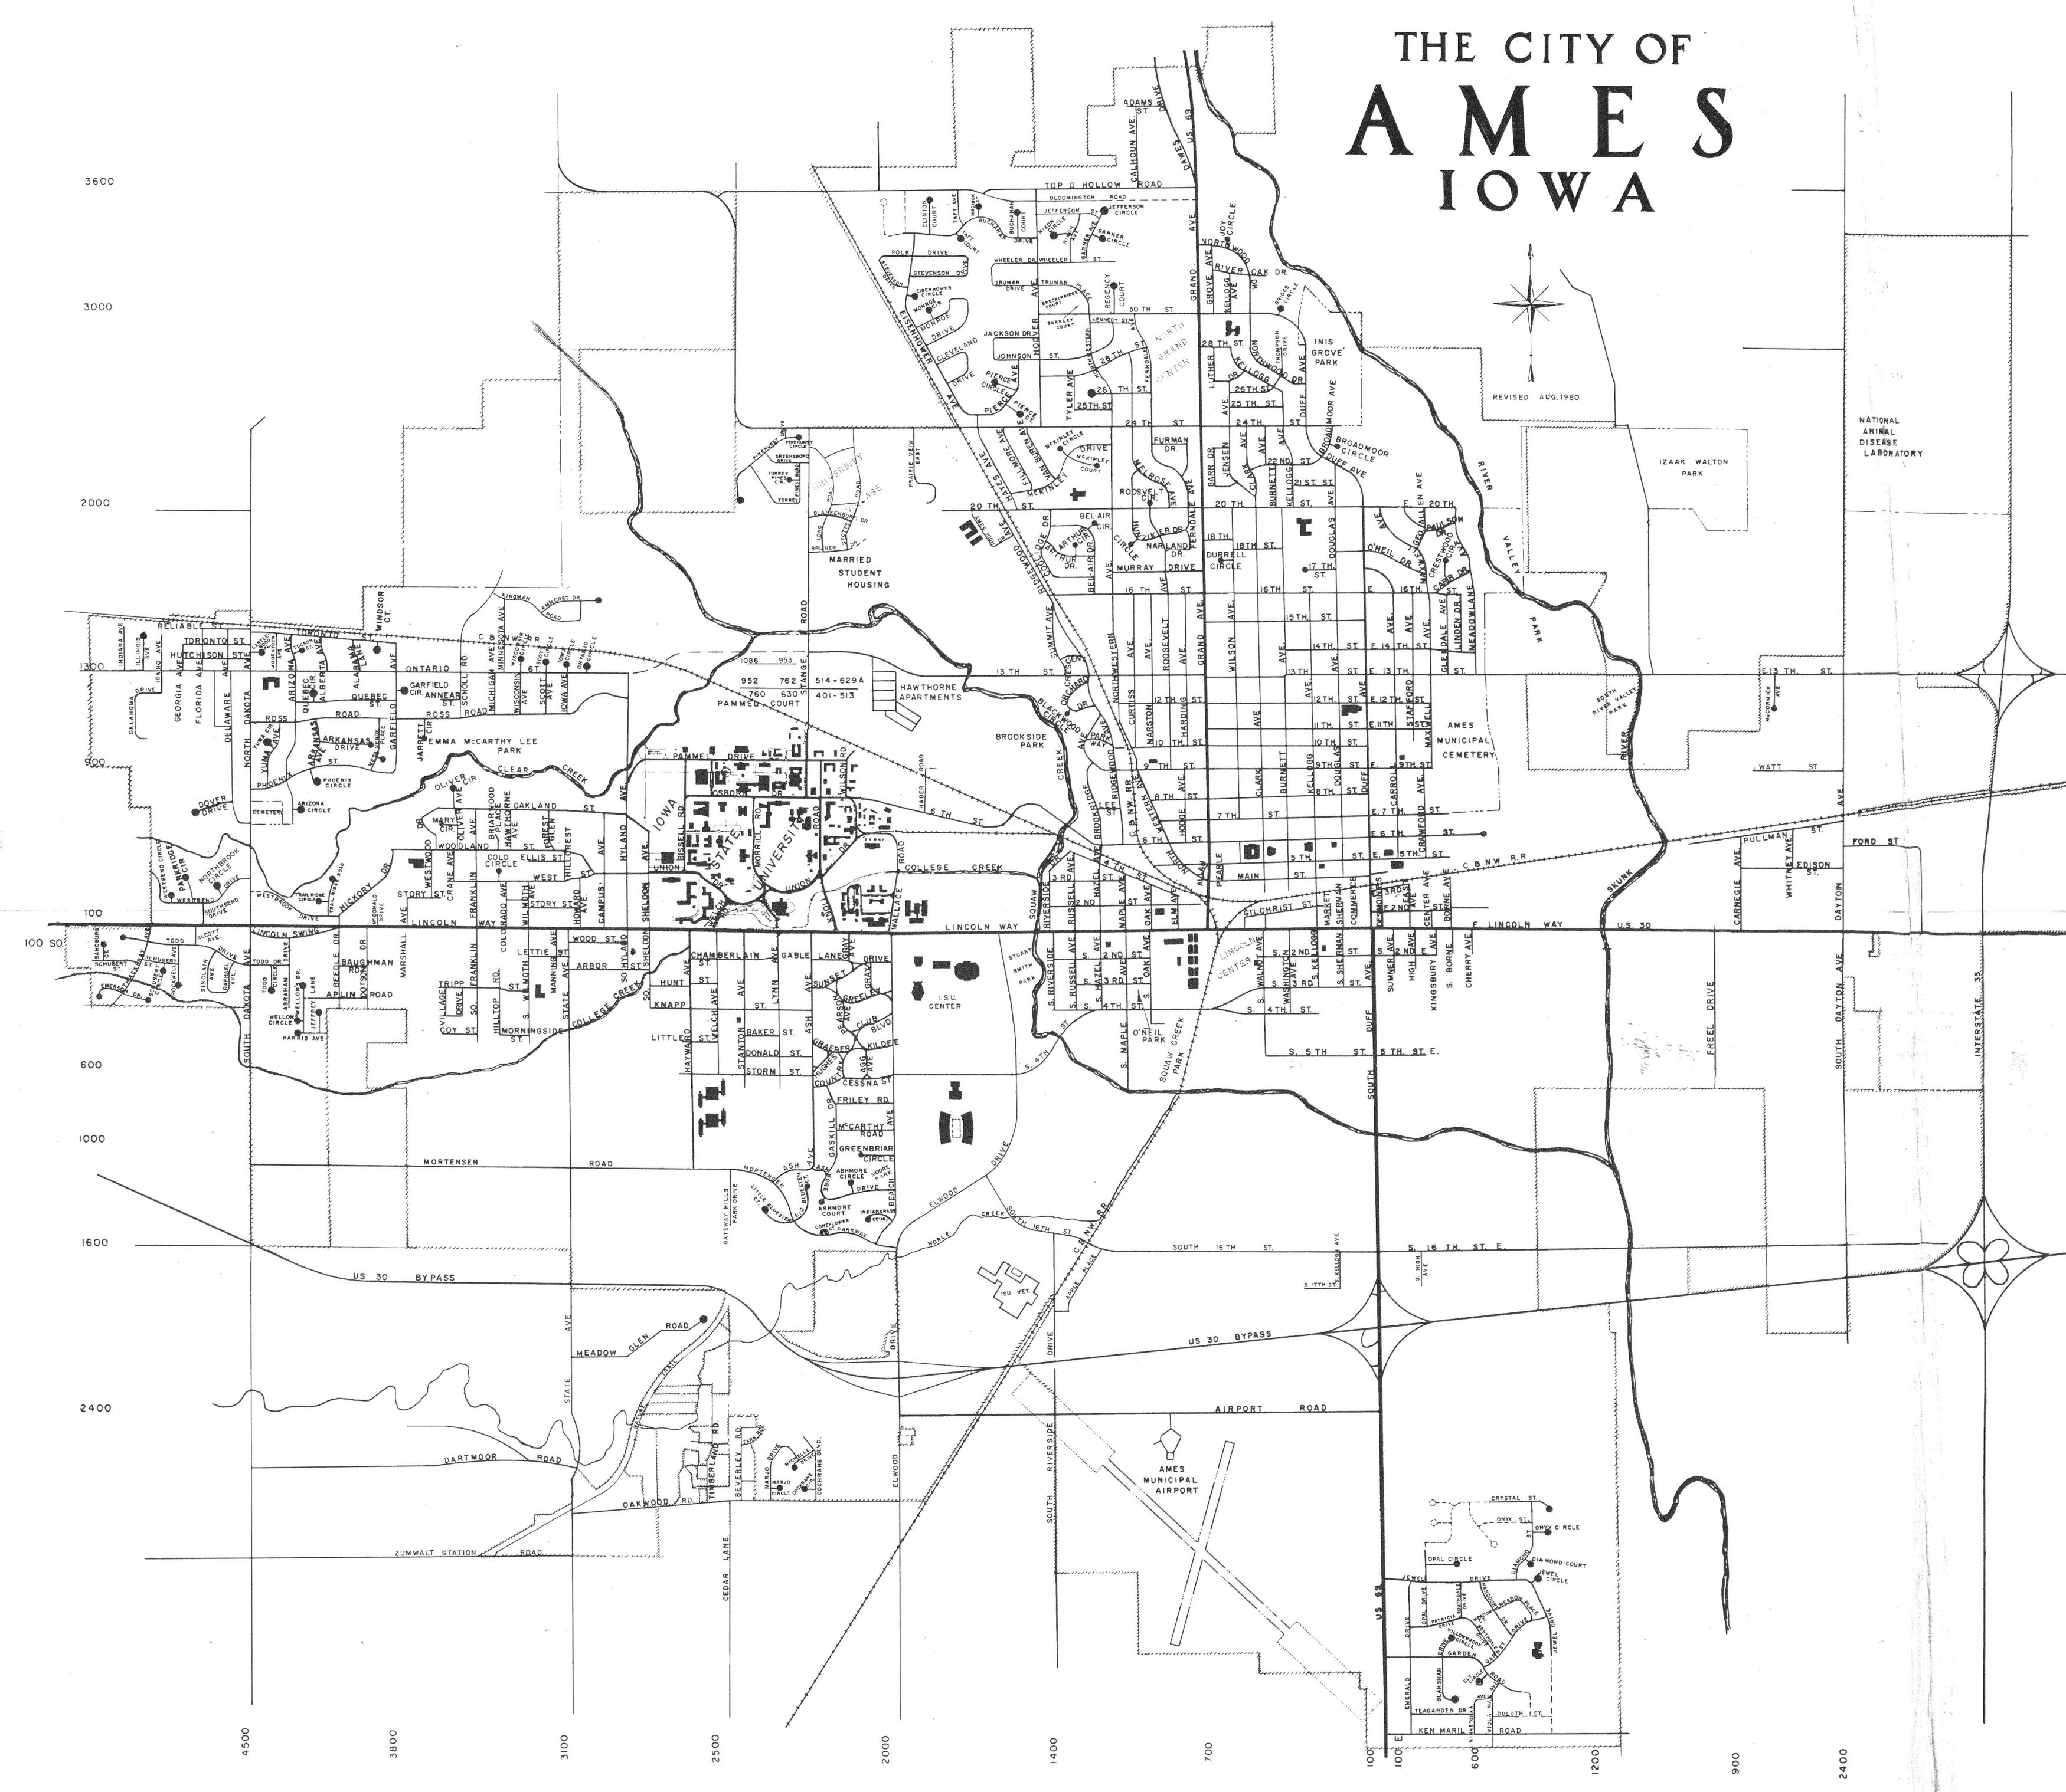
PROJECT #2 Ames Housing Data
Silvia Resende
Set 2022
Notes:
The objective of the project is to develop a regression model to predict the sale price
FOR THOSE WHO OWN A PROPERTY IN THE AMES AREA and want to know how much approximate their property worth in case they decide to sell.
This model could also be interesting for REAL ESTATE COMPANIES since it could be used
to attract customers in the face of a SUPPOSED REAL ESTATE' APPRECIATION
t

Slide 2
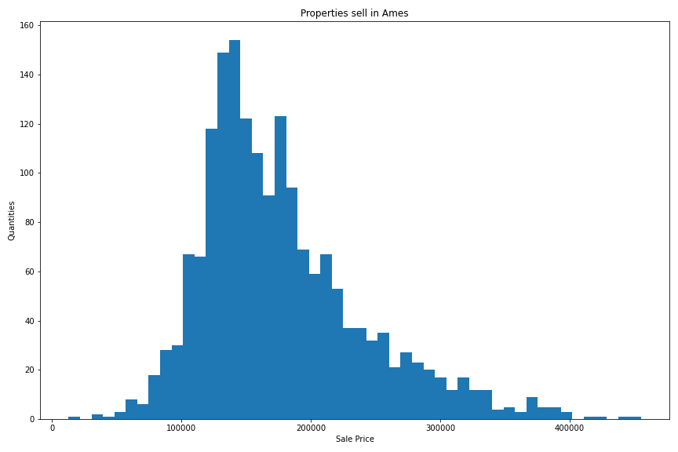
AMES DATA | distribution
Sales:
Histogram of sales
properties for 2006 - 2010
Notes:
QUICK COMMENT about the sample of our data
The prediction model was built on a sample with a slightly skewed normal distribution followed by a process to remove outliers and other distortions

Slide 3
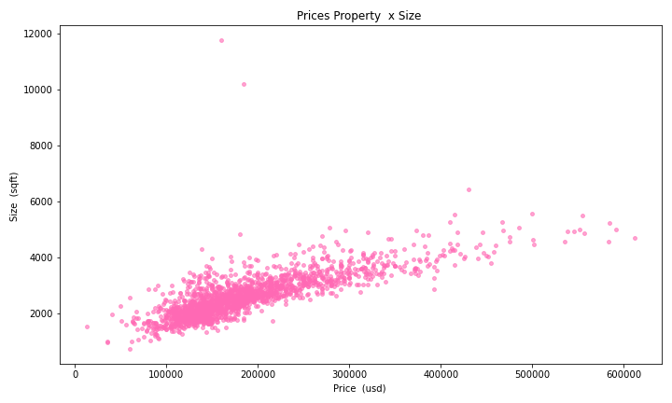
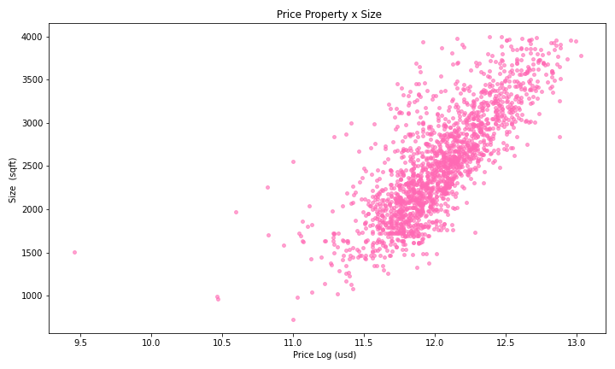
AMES DATA | Outliers
Outliers:
Behavior of sales’ scatter plot after handling outliers
Notes:
Removing outliers and applying transformations in our target (sale price).

Slide 4
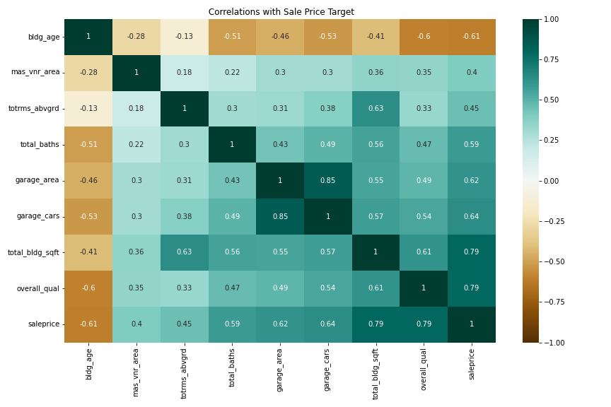
AMES DATA | correlations
Features with strong correlation between sale price
Notes:
We could not observe which variables are strongly related to the target of our model. Some of them are inversely proportional like building age

Slide 5
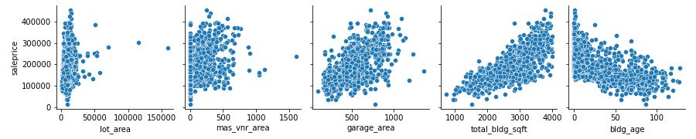
AMES DATA | correlations
Features with strong correlation between sale price
Notes:
Looking at the other relationships with the target, we could observe that the garage area interferes much more with the target than the lot area and we could still observe in more detail the inverse relationship of the age of the property on the target

Slide 6
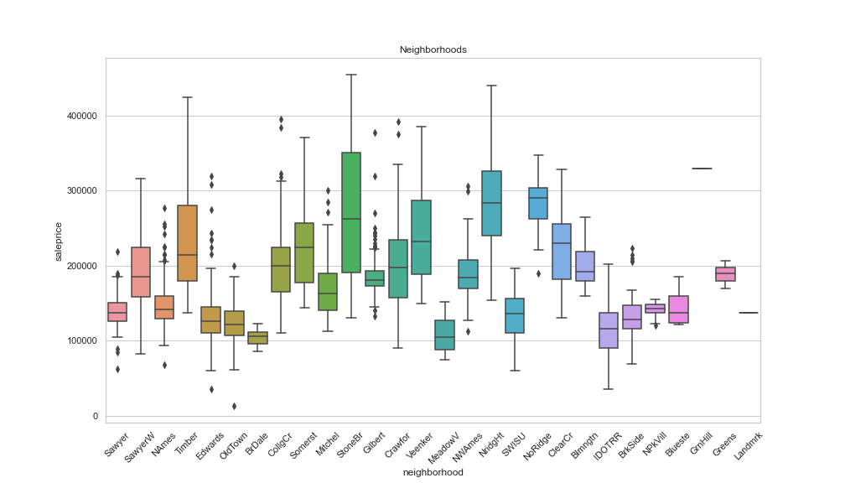
AMES DATA | categorical
Ames’ neighborhoods sales in box plots
Neighborhood Somerst
Neighborhood NridgHt
Neighborhood NoRidge
Neighborhood Crawfor
Notes:
Visualizing the sample with these boxplots, we were able to observe which neighborhoods had the most valued properties like Somerst, NridgHt, NoRidge and Crawfor

Slide 7
AMES DATA | Conclusions
Model Metrics OLS:
MAE: 14809.870050728296
MSE: 416872303.5136811
RMSE: 20417.450955339187
R2: 0.8598253241533164
Training R2: 0.8598253241533164
Validation R2: 0.8422733142022257
Difference: 0.01755200995109063
85.98% of the variance/variability of our sale price,
Can be explained by the features used to build our model.
Notes:
The metric used to evaluate the performance of this model will be the R2 score, which seeks to reduce the distances between the real value of sales prices and those predicted by the model.
85.98% of the variance/variability of our y (price sale),
is explained by the features in our model.

Slide 8
AMES DATA | INFErENCES
Some coefficients:
Total baths: 6755.011
Total building sqft: 20466.00
Total rooms above ground: 649.45
Garage cars: 3048.89
Lot area: 4816.96
Neighborhood Somerst: 1466.12
Neighborhood NridgHt: 3718.50
Neighborhood NoRidge: 2380.81
Neighborhood Crawfor: 4918.21
Notes:
After analyzing the data, we can see that some variables are more important than others in determining the value of real estate prices. For example, the general condition of the property carries more weight than adding a few feet to the size of the property.
In the end, we were able to conclude that not all areas have equal weights, for example, if you want to add value to the property, it will be more efficient to include one more bathroom than a parking space.

Slide 9
AMES DATA Conclusions | recommendations
After analyzing the data, we can see that some variables are more important than others in determining the value of real estate prices. For example, the general condition of the property carries more weight than adding a few feet to the size of the property.
Another conclusion that we can consider is that if you want to add value to the property, it will be more efficient to include one more bathroom than a parking space.
Notes:
After analyzing the data we were able to observe that California students are mostly admitted to institutions through the SAT test.
Another conclusion we can consider is that states with a higher number of admissions, the discrepancy between the two tests is more accentuated
So if you are not sure which test to choose, choose SAT test and
try to apply in any County with more number of admissions

